Slide 1
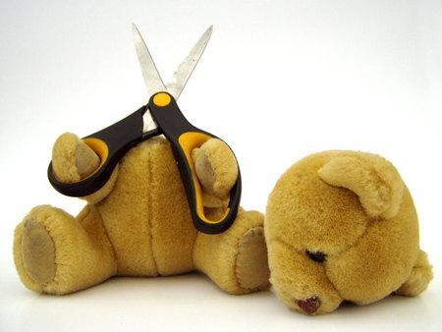
Preventing Suicide
Harley Vergara

Slide 2
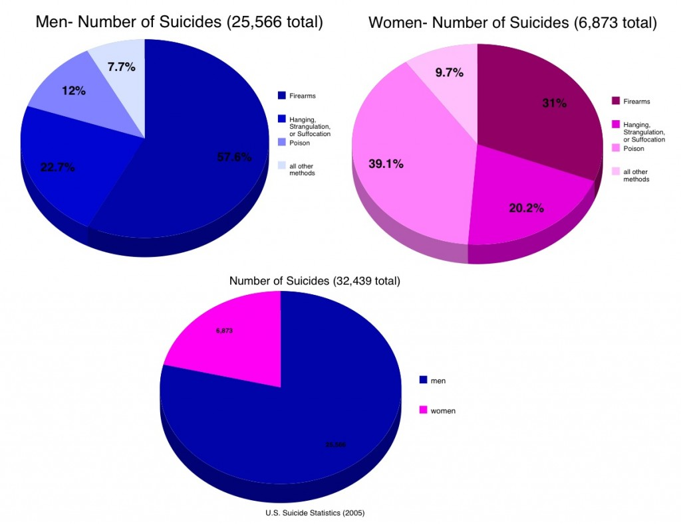

Slide 3
What Is Suicide . . . . .
Suicide is Latin for to kill oneself. Suicide is the act of intentionally causing one's own death. Suicide is often committed out of depression, the cause of which is attributed to a mental disorder such as depression, bipolar disorder, schizophrenia, alcoholism, or drug abuse. Over one million people die by suicide every year. Suicide is estimated to be the 13 most leading cause of death worldwide. It is a leading cause of death among teenagers and adults under 35. The rate of suicide is far higher in men than in women, with males worldwide three to four times more likely to kill themselves than females. There are an estimated 10 to 20 million non-fatal attempted suicides every year worldwide.

Slide 4
Who Is At Risk
are having a serious physical or mental illness,
are abusing alcohol or drugs,
are experiencing a major loss, such as the death of a loved one, unemployment or divorce,
are experiencing major changes in their life, such as teenagers and seniors,
have made previous suicide threats.

Slide 5
Suicide Rates
Suicide rates in the U.S. tend to rise during recessions and fall amid economic booms. It reaches up to 22 people per every 100,000 people

Slide 6
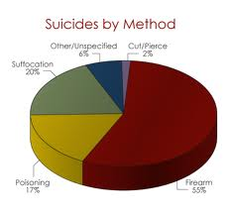
Methdos
The leading methods in different regions include hanging, poisoning, and firearms.

Slide 7
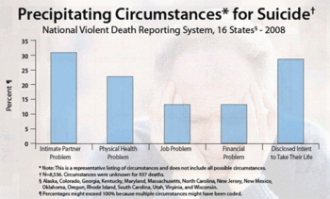
Reasons To Commit Suicide
Depression
Mental Problems
They Don’t Like The Way They Look
They Don’t Know How To Help Their Self.
They have a philosophical desire to die
They Made A Mistake And Don’t Know How To Fix It.

Slide 8
Types Of Suicide
Euthanasia
Murder – Suicide
Suicide Attack
Suicide Pact
Defiance

Slide 9
Substance Abuse Can Lead To Suicide
Cocaine : Misuse of drugs such as cocaine have a high correlation with suicide. Suicide is most likely to occur during the "crash" or withdrawal of the drug.
Methamphetamine : Methamphetamine use has a strong association with depression and suicide as well as a range of other effects on physical and mental health.
Herion : Heroin users have a death rate nearly 13 times that of their non-using peers. Deaths among heroin users attributed to suicide range from 3% to 35%, though determining the difference between a suicide and an accidental overdose. heroin users are 14 times more likely than their non-using peers to die from suicide.
Cigarettes : There have been various studies showing a positive link between smoking, suicidal ideation and suicide attempts. Those smoking between 1 to 24 cigarettes per day had twice the suicide risk; 25 cigarettes or more, 4 times the suicide risk, as compared with those who had never smoked.
Alcohol : Alcohol misuse is associated with a number of mental health disorders, and alcoholics have a very high suicide rate. It has been found that drinking 6 drinks or more per day results in increased risk of suicide.

Slide 10
Warning sings of Suicide
Warning signs that an individual is imminently planning to kill themselves may include the person making a will, getting his or her affairs in order, suddenly visiting friends or family members, buying instruments of suicide like a gun, hose, rope, pills or other forms of medications, a sudden and significant decline or improvement in mood, or writing a suicide note.

